Slide 1


PRADEEP KUMAR REDDY BANDI
31-MAY-2022

Slide 2

Outline
Executive Summary
Introduction
Methodology
Results
Conclusion
Appendix
<number>
Notes:
<number>

Slide 3
Executive Summary
Summary of methodologies
Data collection using spaceX API
Data collection using webscraping
Data wrangling
Exploratory Data Analysis with SQL
Exploratory Data Analysis with Visualization
Build an interactive map using Folium
Interactive visual analytics dashboard using plotly
Summary of all results
Exploratory data analysis results
Interactive analytics demo in screenshots
Predictive analysis results
2

Slide 4
Introduction
Project background and context
SpaceX advertises Falcon 9 rocket launches on its website with a cost of 62 million dollars; other providers cost upward of 165 million dollars each, much of the savings is because SpaceX can reuse the first stage. Therefore if we can determine if the first stage will land, we can determine the cost of a launch. This information can be used if an alternate company wants to bid against SpaceX for a rocket launch.
Problems you want to find answers
1)Determine the price of each launch
2)Determine if the first stage will land successfully.
3

Slide 5

Section 1
4

Slide 6
Methodology
Executive Summary
Data collection methodology:
Data was collected using Request to SpaceX API and Webscraping.
Perform data wrangling
We found the unique outcomes in outcome column and then segreagated the good and bad outcomes. A new class column was created based on good and bad outcomes with values(1 for good) and (0 for bad).This helped us in classifying the successful and failed lauches.
Perform exploratory data analysis (EDA) using visualization and SQL
Perform interactive visual analytics using Folium and Plotly Dash
4
Notes:
<number>

Slide 7
Methodology
Executive Summary
Perform predictive analysis using classification models
We can build classification models by splitting the data into test and training sets and then training the model on training set.
We can tune the model by finding the best parameter combinations per model.
We can evaluate the models by finding the best scores of each model,their scores on the test data prediction and also using metrics like jaccard and f1scores.
6
Notes:
<number>

Slide 8
Data Collection
Data was collected by sending get request to SpaceX API.
The values like rocket ids,cores in the response from spaceX API are used to get more information by sending more get requests to the API.
Data was also collected using Web scraping where the tables obtained using Beautiful soup are iterated to get different columns like Booster version,flight number etc which are then used to create a dataframe.
7

Slide 9
Data Collection – SpaceX API
Start the data collection
Get the past launches of SpaceX using the
requests.get(spacexpastlaunchesurl)
Is response status
code==200
Check for the right url online and send get request again
Normalize the json response using pandas json_normalize() and
Store the result in a pandas dataframe
8
A

Slide 10
Data Collection – SpaceX API
A
Use the columns like rocket,payload etc from dataframe to send get requests to SpaceX
API and use the results to create new columns in dataframe like launchsite,orbit etc
Filter the Falcon9 laucnhes in data frame using the masking condition
data['BoosterVersion']!='Falcon 1'
Replace the missing values in payload column with the column mean
Using fillna() of dataframe and mean() of series
Stop the data collection and save the data(dataset_part_1.csv)
9

Slide 11
Data Collection – SpaceX API
The GitHub URL of the completed SpaceX API calls notebook is
https://github.com/pradeepkrb86/SpaceX_Capstone/blob/main/jupyter-labs-spacex-data-collection-api.ipynb
10

Slide 12
Data Collection - Scraping
Start Data collection using Web scraping
Get the Falcon 9 lauch data from its wiki page using requests.get()
And then pass response.text to BeautifulSoup() to create a soup object
Create a list of HTML tables using find_all() method on the soup object
Create an empty dictionary with keys like Flightno,Orbit etc and values
As empty lists.
A
11

Slide 13
Data Collection - Scraping
A
Iterate over the html tables using enumerate and append the data from
Table cells into the lists(values of the dictionary)
Create a dataframe using dictionary comprehension
using keys and the values
(type casted to series) from the dictionary
Stop Data Collection using scraping
(save the df to spacex_web_scraped.csv)
The GitHub URL of the completed web scraping notebook is
https://github.com/pradeepkrb86/SpaceX_Capstone/blob/main/jupyter-labs-webscraping.ipynb
12

Slide 14
Data Wrangling
Start Data Wrangling
Read the dataset_part_1.csv(obtained from data collection
Using spaceX API) into a pandas dataframe named df
Find the unique values in Outcome column of df using value_counts() which
Returns a series
Extract the bad outcomes from the series using keys() method and
Filtering the bad outcomes using the returned index by keys
A
13

Slide 15
Data Wrangling
A
Create a new list named landing_class and append value 0 to it for bad
And 1 for good outcomes.Assign this list to class column in df
Stop Data Wrangling(save the df to dataset_part_2.csv)
The GitHub URL of completed data wrangling notebook is
https://github.com/pradeepkrb86/SpaceX_Capstone/blob/main/labs-jupyter-spacex-Data%20wrangling.ipynb
14

Slide 16
EDA with Data Visualization
Scatter point charts:
Were used to visualize the affect of the different combinations of input features like
a)Payload and launchsite
b)Flight number and launchsite
c)Flight number or payload with orbit type
on the launch outcome.
Bar chart:
Was used to compare the success rate of each orbit type.
Line plot:
Was used to see the average success rate over the years from 2010 to 2020.
The GitHub URL of completed EDA is https://github.com/pradeepkrb86/SpaceX_Capstone/blob/main/jupyter-labs-eda-dataviz.ipynb
15

Slide 17
EDA with SQL
Summary of SQL Queries
Select names of unique launch sites.
Find the first 5 records where launch site names starts with CCA.
Calculate the total payload mass carried by all boosters of NASA (CRS).
Find average payload mass carried by Booster version F9 v1.1.
Display the date when first successful landing outcome in groundpad was achieved.
Find names of boosters with payload mass between 4000 and 6000 kg and have success in drone ship.
Number of success and failure mission outcomes.
16

Slide 18
EDA with SQL
Summary of SQL Queries continued...
Booster versions which carried maximum payload of mass.
Failed landing outcomes along with booster versions and launch site names in year 2015.
Ranking of total landing outcomes for each landing outcome type between 2016-06-04 and 2017-03-20.
The GitHub URL of completed EDA with SQL notebook is
https://github.com/pradeepkrb86/SpaceX_Capstone/blob/main/jupyter-labs-eda-sql-coursera.ipynb
17

Slide 19
Build an Interactive Map with Folium
Summarize of map objects
We added map objects such as markers,circles,lines to the map.
Significance of the map objects.
Circles indicated the launch site locations on the maps.
Marker clusters indicated the success and failed launches at each site.
Lines showed the distance between a launch site and its proximities.
The GitHub URL of completed interactive map with Folium map is
https://github.com/pradeepkrb86/SpaceX_Capstone/blob/main/lab_jupyter_launch_site_location.ipynb
18

Slide 20
Build a Dashboard with Plotly Dash
Summary of plots/graphs and interactions in the dashboard
We added a pie chart and a scatter plot to the dashboard.
We provided an interactive launch site selection to the pie chart and payload range selection to the scatter plot
Pie chart depicts the success rate of all sites in comparison with one another as well as the success and failure of each individual launch sites.
Scatter plot allows us to see the success rate dependency on the payload range.
The GitHub URL of your completed Plotly Dash lab is
https://github.com/pradeepkrb86/SpaceX_Capstone/blob/main/spacex_dash_app.py
19

Slide 21
Predictive Analysis (Classification)
Start the Machine Learning(ML) Prediction
Read the dataset_part_3.csv(obtained from EDA using data
Using data visualization) into a pandas dataframe named X
Standardize the data in X using preprocessing.StandardScaler()
And reassign it to X
Split X into training and test data using train_test_split with test size as
0.2 and random state as 2
A
20

Slide 22
Predictive Analysis (Classification)
A
Create an object for logistic regression(LR) model and create a Grid Search
CV Object by passing the object of LR,parameters and CV=10
Find the best parameter combination and best score for the CV object
using its best_params_ and best_score_ attributes.
Find the score for the CV object on test data and plot a confusion matrix
using the predicted yhat for LR and actual test data
Repeat the above 3 steps and create a models using KNN,SVM and
Decision tree classifier.
B
21

Slide 23
Predictive Analysis (Classification)
B
Evaluate the metrics for all models created using scores on test data
And each models best score and othe metrics like Jaccard and f1 scores.
Also compare the confusion matrices created for each model.
Conclude on the best model using data visualization like
Bar plot for all the metrics for all models
Stop the ML prediction
The GitHub URL of Machine Learning prediction notebook is
https://github.com/pradeepkrb86/SpaceX_Capstone/blob/main/SpaceX_Machine%20Learning%20Prediction_Part_5.ipynb
22

Slide 24
Results
Exploratory data analysis results
Interactive analytics demo in screenshots
Predictive analysis results
24
Notes:
<number>

Slide 25

Section 2

Slide 26
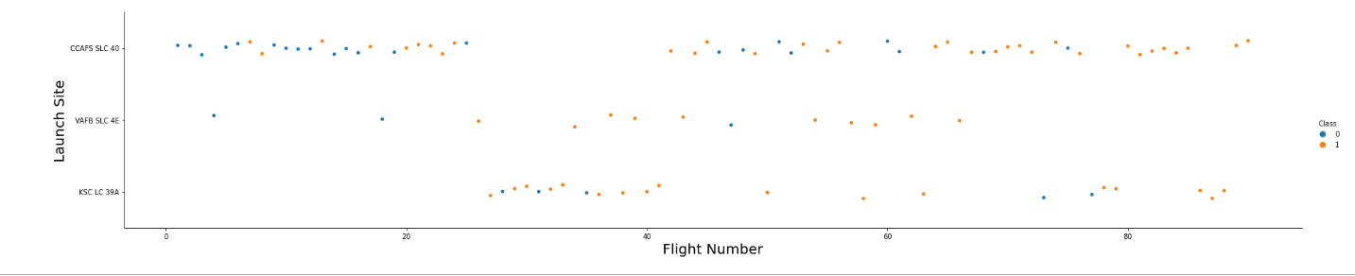
Flight Number vs. Launch Site
As the flight number increases the sucess rate also increases for all sites.
KSC LC 39 A has a good success rate over all flight numbers.
24

Slide 27
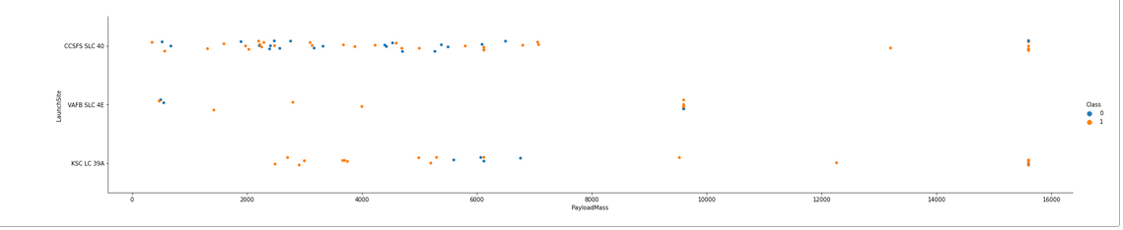
Payload vs. Launch Site
The greater is the payload the lesser is the number of launches attempted at each site.
KSC LC 39A has a good success rate over the entire payload except around 6000 where we can observe
all the failures at this site.
26

Slide 28
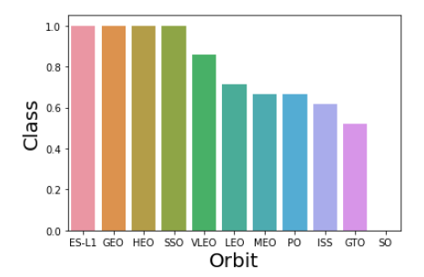
Success Rate vs. Orbit Type
The orbit type is not impacting the success rate.
GEO,SSO,ES-L1 and HEO are having the highest success rate.
Other orbits have the success rate with very minimal variation.
27

Slide 29
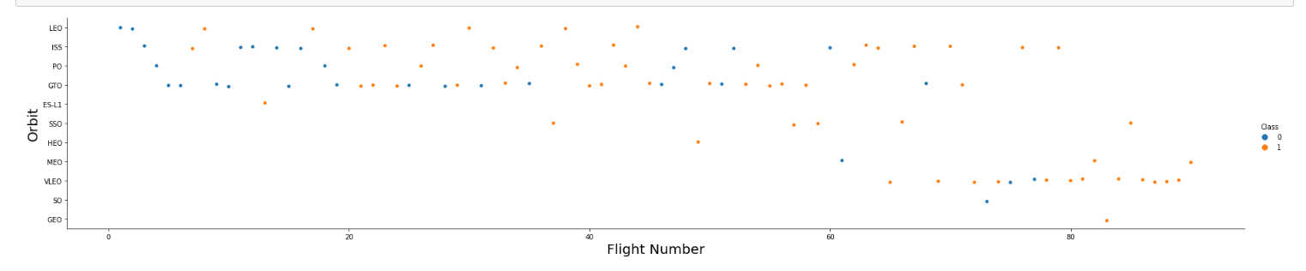
Flight Number vs. Orbit Type
The failures are less at higher flight number range(like 60 and above).
In the LEO orbit, the Success appears related to the number of flights.
There seems to be no relationship between flight number when in GTO orbit.
28

Slide 30
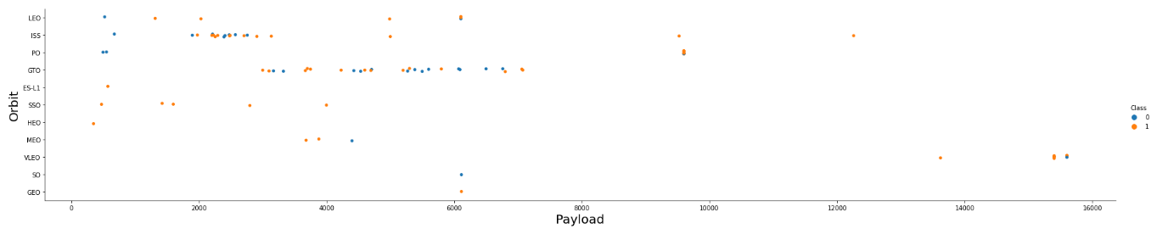
Payload vs. Orbit Type
There are hardly any launches in the higher payload range.
In SSO there are no failures in any payload range.
With heavy payloads the successful landing rate are more for Polar,LEO and ISS.
29

Slide 31
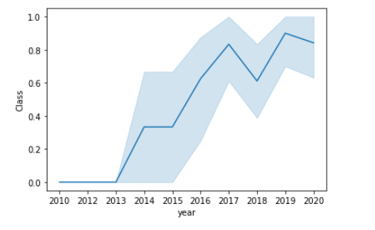
Launch Success Yearly Trend
Success rate kept on increasing starting from year 2013 with a slight drop at 2018 and later at 2020.
30

Slide 32
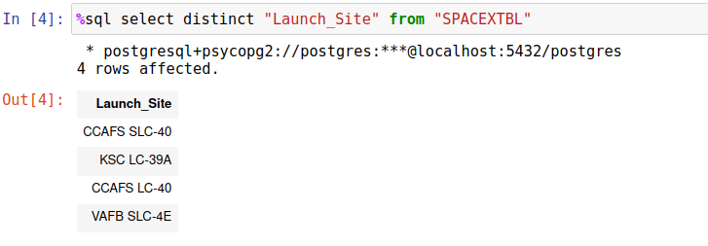
All Launch Site Names
We can see there are in total four unique launch sites used by SPACEX.
We can use distinct to find unique values in a column.
31

Slide 33
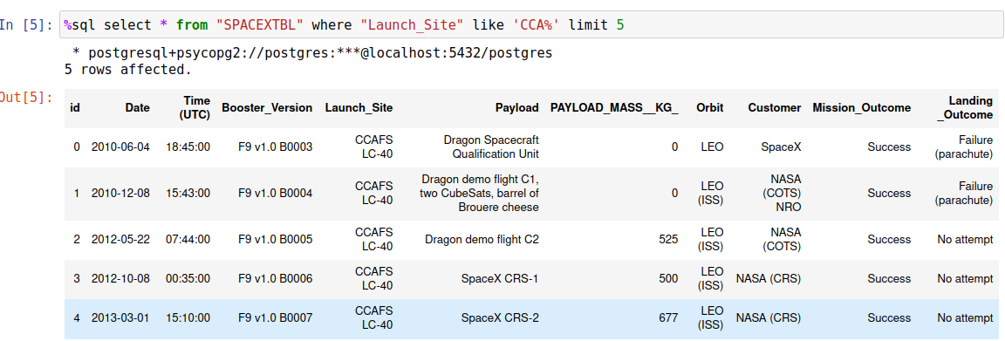
Launch Site Names Begin with 'CCA'
Below are first 5 records where launch_sites begin with ‘CCA’.
We can use limit to limit the number of records displayed.
32

Slide 34
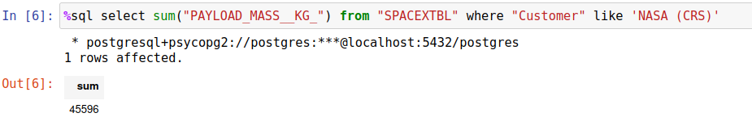
Total Payload Mass
The total payload carried by boosters from NASA is 45596 kg.
Here sum on a column gives us the total value and where restricts the records on which the sum is to be performed.
33

Slide 35
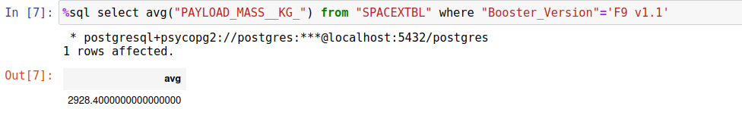
Average Payload Mass by F9 v1.1
AVG function a long with search of F9 v1.1 pattern in booster version is applied on the Payload mass column to obtain the average payload and the average is 2928.40
34

Slide 36
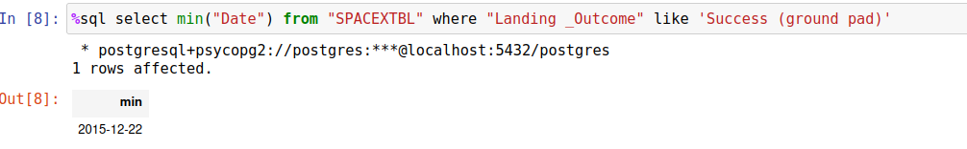
First Successful Ground Landing Date
The first successful ground landing outcome by SPACEX was achieved in the year 2017.
Min gives the earliest date in a Date column.
35

Slide 37
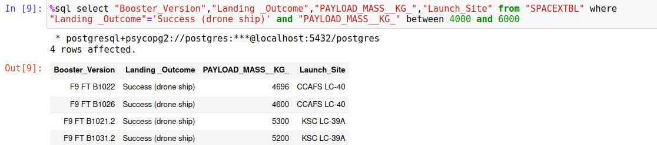
Successful Drone Ship Landing with Payload between 4000 and 6000
We can observe that all successful drone ship landings with payload mass between 4000 and 6000 all have booster version belonging to F9 FT.
36

Slide 38
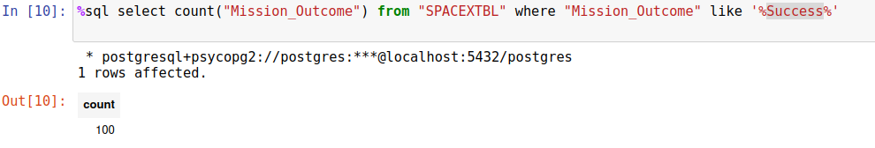
Total Number of Successful and Failure Mission Outcomes
Successful Outcomes.
Failure Outcomes. We can observer only 1% failure.
37

Slide 39
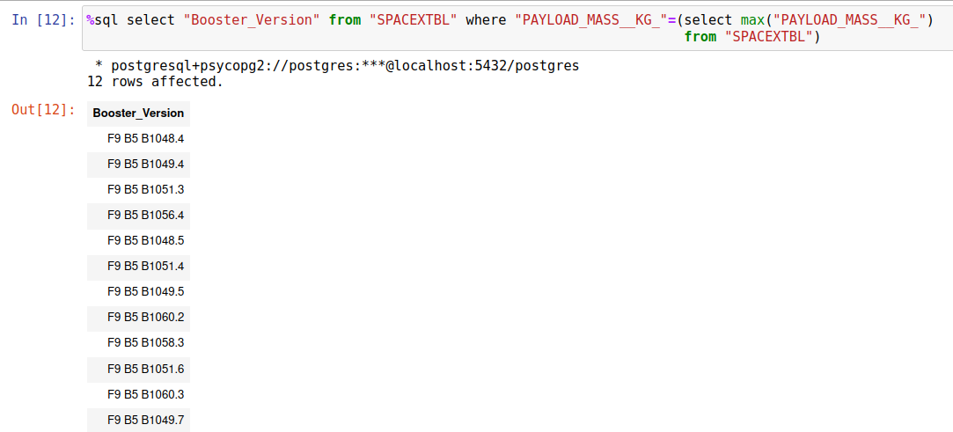
Boosters Carried Maximum Payload
Boosters with maximum payload are all observed as belonging to B5 as seen below.
38

Slide 40
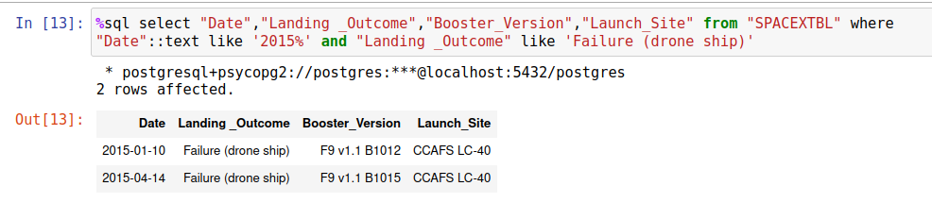
2015 Launch Records
Below result is obtained by searching for Failure (drone ship) and year like 2015(from date type casted to text).
We can observe that all the failed landing outcomes in 2015 were only at the launch site CCAFS LC-40.
39

Slide 41
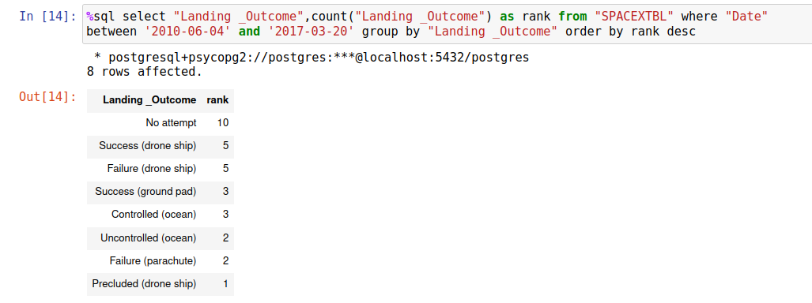
Rank Landing Outcomes Between 2010-06-04 and 2017-03-20
Count of landing outcomes between the date 2010-06-04 and 2017-03-20, in descending order. Around 30% laucnhes were not attempted during this period.
40

Slide 42

Section 3

Slide 43
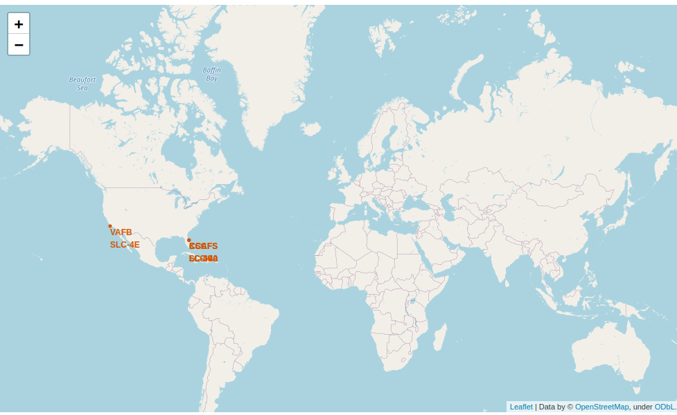
SpaceX Launch sites on World Map
Each site name can be clearly seen in the next slide.All sites are located near the United
States
41

Slide 44
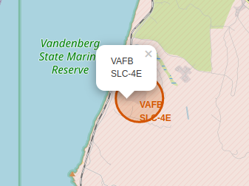
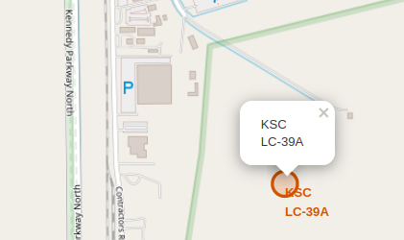
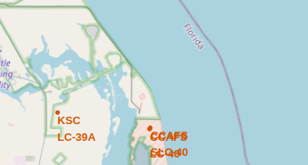
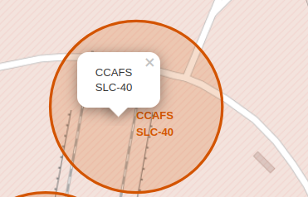
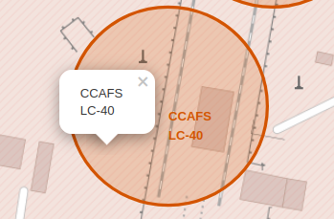
Majority of the sites are located near
Florida coast

Slide 45
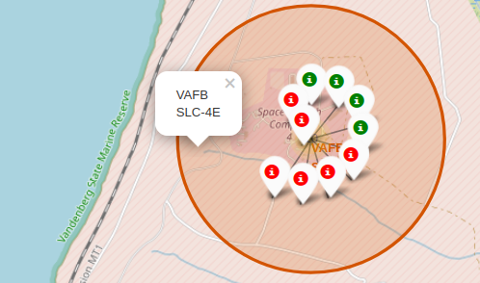
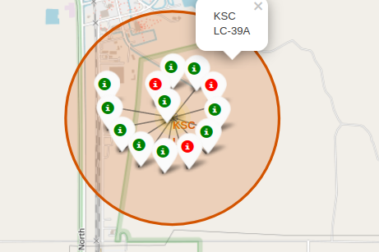
Launch outcomes for each site
Successful Launches are indicated by green markers and Failed launches are indicated by red markers.
43
45

Slide 46
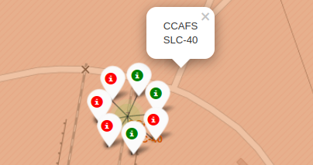
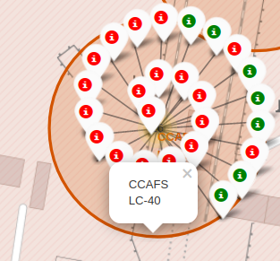
Launch outcomes for each site
From Launch outcomes for all sites we observe that
KSC LC site has the highest number of Successful Launch outcomes
whereas CCAFS SLC-40 has the least percentage of successful launches.
45
46

Slide 47
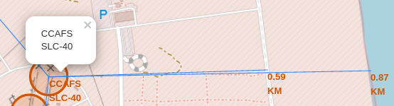
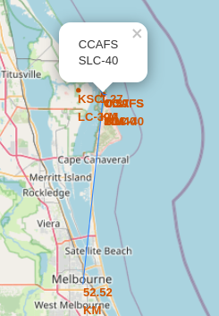
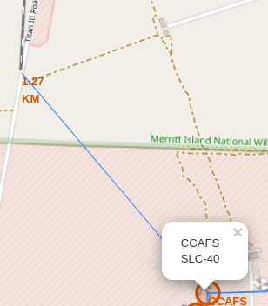
CCAFS SLC-40 Launch Site and its proximities
CCAFS SLC-40 site is very near to the coastline(0.87 km) and far from the city Melbourne(around 52 KM)
46

Slide 48

Section 4

Slide 49
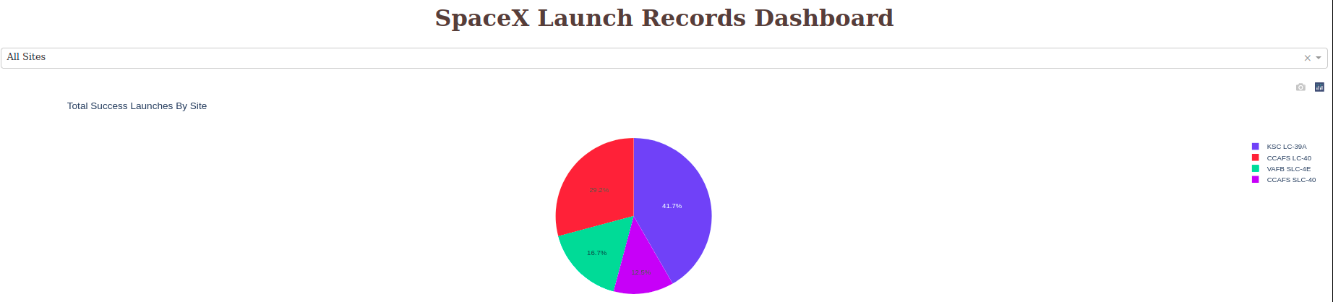
Success rate of all Launch Sites
Highest Success rate is for KSC LC site
47

Slide 50
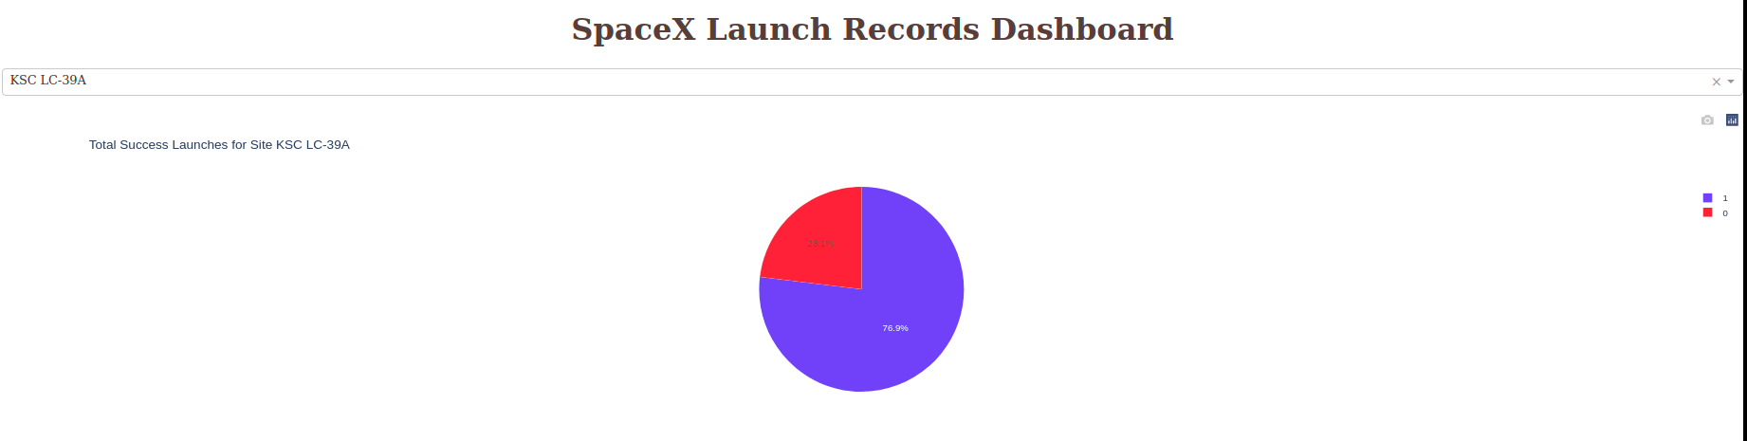
Lauch Site KSC LC-39A Success and Failure
This site Success rate is higher than 75%
49

Slide 51
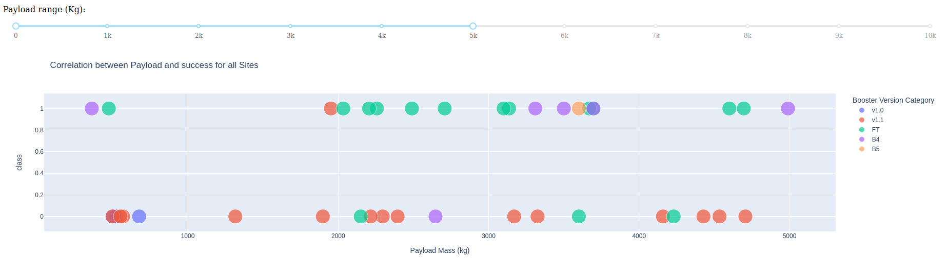
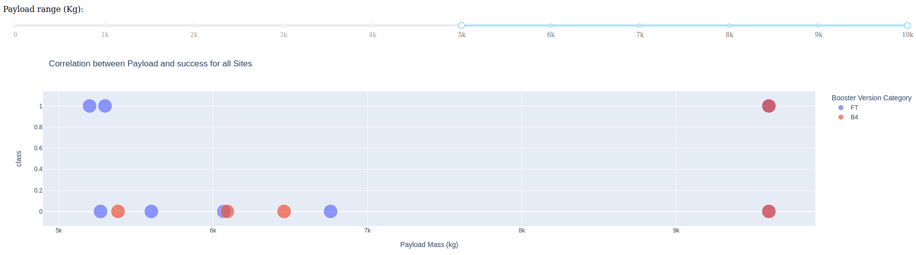
Payload vs. Launch Outcome for all sites with different Payload Range
Booster version FT has higher success rate in all Payload ranges
50

Slide 52

Section 5

Slide 53
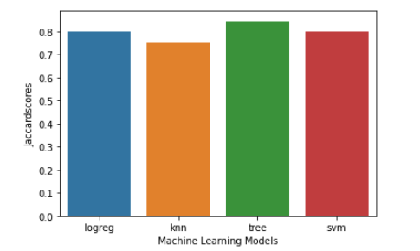
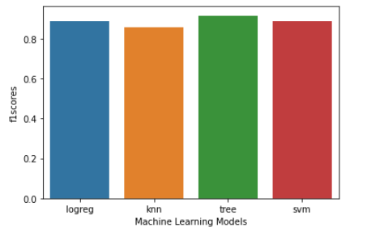
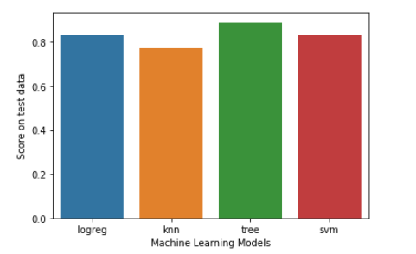
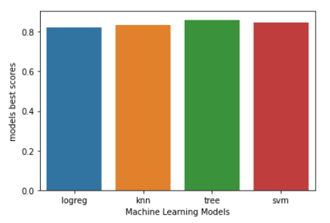
Classification Accuracy
From all bar plots for different metrics of all models below, we can observe that decision tree is the best model.
51

Slide 54
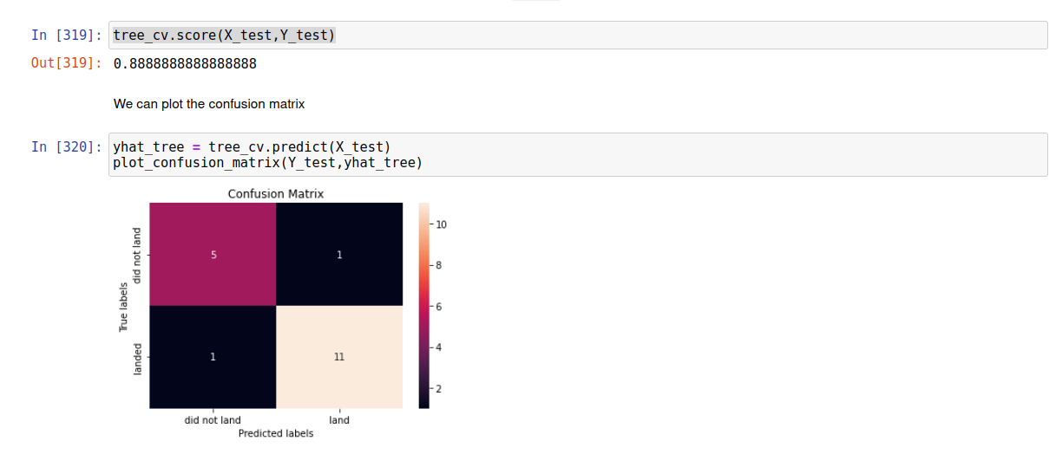
True labels(sum in rows) and predicted labels
(sum in columns) are exactly equal indicating descision tree as best model.
Confusion Matrix
53

Slide 55
Conclusions
KSC LC-39 A has the most successful launches of all sites.
Decision tree classifier with a specific parameter combination is the best of all Machine learning Algorithms.Confusion matrix with this combination shows 100% equality between true and predicted labels.
Booster Version FT has the highest success rate for all payload ranges.
Launch sites like CCAFS SLC-40 site is very near to the coastline(0.87 km) and far from the city Melbourne(around 52 KM).
GEO,SSO,ES-L1 and HEO orbits are having the highest success rate.
Success rate kept on increasing starting from year 2013 with a slight drop at 2018 and later at 2020.
<number>

Slide 56
Appendix
https://github.com/pradeepkrb86/SpaceX_Capstone.git
55
Notes:
<number>

Slide 57


